Slide 1


Phishing Attacks Explained
NAME: ARIYO TEMITOPE FELIX DATE: DEC 2024

Slide 2
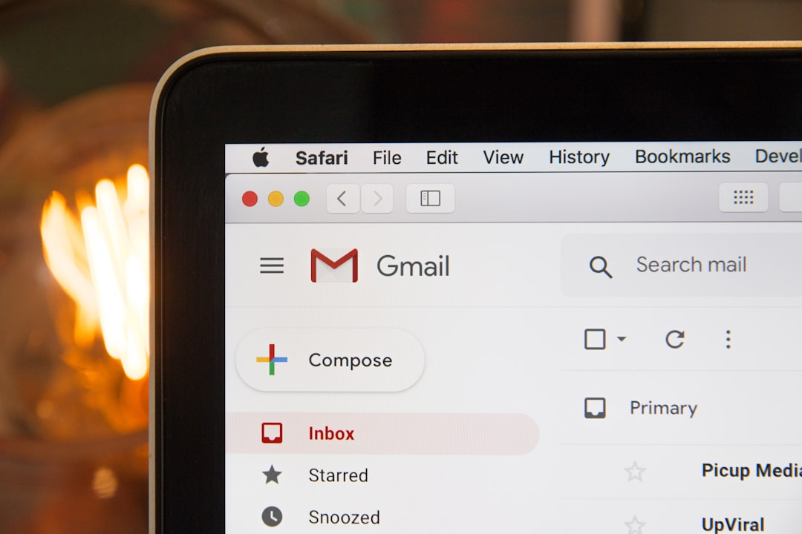
Types of Phishing
EMAIL PHISHING
SPEAR PHISHING
The most common method, utilizing fake emails that appear legitimate to trick users into revealing personal information.
Vishing (Voice Phishing): Involves using phone calls to extract information.
Smishing (SMS Phishing): Phishing via SMS or text messages.
Targeted phishing attacks aimed at specific individuals or organizations, often using personal information to gain trust.
Clone Phishing: Duplicating legitimate emails with malicious links or attachments.

Slide 3


Recognizing Phishing Emails
SUSPICIOUS LINKS OR ATTACHMENTS
Hover over links to see their true destination. Unexpected attachments should not be opened.
POOR GRAMMAR AND SPELLING
Legitimate organizations usually check their emails thoroughly. Mistakes can indicate a phishing attempt.
URGENT CALLS TO ACTION
Phishing emails often create a sense of urgency, pressuring the recipient to act quickly without thinking.

Slide 4

Avoiding Phishing Websites
Identifying phishing websites is crucial. Look out for specific indicators like unusual URLs, connection types, and design quality.
INDICATOR | DESCRIPTION | ACTION
Unusual URL | Check for typos or domain variations | Do not enter personal info
Non-HTTPS connection | Secure sites use HTTPS | Avoid inputting sensitive data
Generic Greetings | Phishing sites often use vague salutations | Be suspicious of lack of personalization
Poor Design | Legitimate companies maintain a professional look | Leave the site if it appears unprofessional

Slide 5


Social Engineering Tactics
PRETEXTING
Offers enticing products or services that require personal data, tricking users into giving up sensitive information.
BAITING
Scammers create a fabricated scenario to steal personal information, often pretending to be from legitimate organizations.

Slide 6
Phishing Statistics
65%
25%
10%
COMMON ATTACK VECTOR
TARGETED APPROACH
EMERGING FORMS
Email remains the most used method for phishing attacks.
Spear phishing targets specific individuals or organizations.
Includes phone phishing and SMS phishing.

Slide 7


Preventive Measures
STEPS TO PROTECT YOURSELF
Enable two-factor authentication, use strong passwords, and regularly update software. Be cautious of unsolicited communications and verify sources.

